Slide 1

Systems of Neuromorphic Adaptive Plastic Scalable Electronics
Bidder’s Workshop and Teaming Meeting
March 4, 2008
Dr. Todd Hylton, Program Manager
DARPA DSO
Approved for Public Release, Distribution Unlimited
1

Slide 2
Introduction and Motivation
Approved for Public Release, Distribution Unlimited

Slide 3
Motivation and Objective
Problem
As compared to biological systems, today’s intelligent machines are less efficient by a factor of a million to a billion in complex environments.
For intelligent machines to be useful, they must compete with biological systems.
Objective
Develop electronic, neuromorphic machine technology that scales to biological level.
[log]
von Neumann Machines
A trade between universality and efficiency
Machine Complexity
e.g. Gates;
Memory;
Neurons;
Synapses
Power;
Size
Neuromorphic Machines
Human level performance
Dawn of a new age
Dawn of a new paradigm
Program Objective
“simple”
“complex”
[log]
Human Cortex | Simulated Human Cortex
15 Watts | 10¹⁰ Watts
I Liter | 4x 10¹⁰ Liters
Environmental Complexity
e.g. Input Combinatorics
Lansner et al
The SyNAPSE program seeks to break the programmable machine paradigm and define a new path for creating useful, intelligent machines
Approved for Public Release, Distribution Unlimited

Slide 4
Vision & Impact
Historical Evolution of Modern Electronics
End of scaling
Defect intolerant
Architectural bottleneck
Software limited
No path to biologically competitive intelligence
Transistor
IC
µProcessor
& memory
Programmable
machines
60 years
DARPA SyNAPSE
Increased component density
Increased component function
Defect tolerant
Neuromorphic information, learning, cognition, understanding architecture
Path to biologically competitive intelligence
Vision for the Future
Electronic
Synapse
“Cortical”
Microcircuit
“Cortex”
Fabric
Intelligent
machines
<<60 years
The SyNAPSE program seeks to extend the development of modern electronics into a new revolutionary new era using a similar paradigm.
Approved for Public Release, Distribution Unlimited

Slide 5
Inspiration
Biological-Scale Neuromorphic Electronic Devices
Human NeoCortex | Neuromorphic Electronics
~10¹⁰ synapses/cm² | 10¹⁰ intersection/cm² in crossbar arrays w/ 100 nm pitch
~10⁶ Neurons/cm² | ~5x10⁸ transistors/cm² in state of the art CMOS
~5 x 10⁸ long range axons @ ~1 Hz | ~30 Gbit/sec multiplexed digital addressing
Conclusion: Gross statistics of biological neural systems might be realized in modern electronics.
Approved for Public Release, Distribution Unlimited

Slide 6
Key Challenges and Goals
Approved for Public Release, Distribution Unlimited

Slide 7
Key Goal: Electronic Synapse
Axonic electrode
Dendritic electrode
Crossbar synapse
Soma
The electronic synapse performs computation, memory, and adaptation in a neuromorphic system. Computation occurs in the electron current (i=v*g) injected through the synapse conductance g between neurons in response to (spike) voltage v. Memory occurs as a slowly changing electrophysical property that modifies g. Neuromorphic adaptation (aka plasticity) occurs as g changes in response to the same voltages used for computation.
Approved for Public Release, Distribution Unlimited

Slide 8
Key Goal: Spike Time Dependent Plasticity
Pulse interference
at the synapse
Δt
Post-synaptic
Neuron
synaptic potential
t_{pre}
t_{post}
time
Pre-synaptic
Neuron
Neurons encode information as “spikes” and communicate to other neurons in both both forward (axonic) and backward (dendritic) directions. The time-relation between forward and backward spikes arriving at a synapse determines if the synaptic connection should be increased or decreased. Connection strength increases (decreases) whenever forward spikes are causally (acausually) correlated to backward spikes.
τ₊
% change in synaptic conductance
0
τ₋
0
Δt = (t_{pre} – t_{post})
Approved for Public Release, Distribution Unlimited

Slide 9
Key Goal: Neuromorphic Architecture
Possible approaches
  “Bottom-up” based on neuro-psycho-physical models of biological systems
  “Top-down” based on large scale neuro-informatics / connectomics
  Artificial Neural Networks
  First principles design
  “Evolutionary” optimization of model structures
Approved for Public Release, Distribution Unlimited

Slide 10
Key Goal: Electronic Implementation
Chip fabrication
  Novel materials and structures on CMOS
Spike processing
  Spike time encoding
  Spike time dependent plasticity
Connectivity
  Hardwired
  Addressed / programmable
  On-chip / off chip
Power
Size
Supports Neuromorphic Architecture
Approved for Public Release, Distribution Unlimited

Slide 11
Key Goal: Large Scale Simulation
Using programmable machines to design and test intelligent machines
  Architectural design, validation, development
  Chip design / validation
  Mammalian scale simulations of systems and components
  Functional performance testing in environments
Large scale digital hardware
  “Supercomputer” scale
  Specialized hardware development may be appropriate
  Rebuilding the current computer architecture “from scratch” is outside the scope of this solicitation
Approved for Public Release, Distribution Unlimited

Slide 12
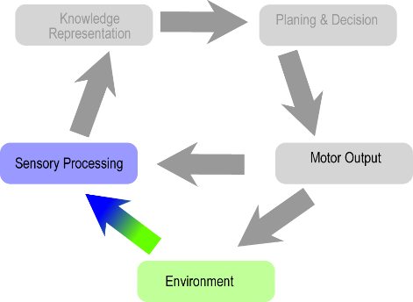
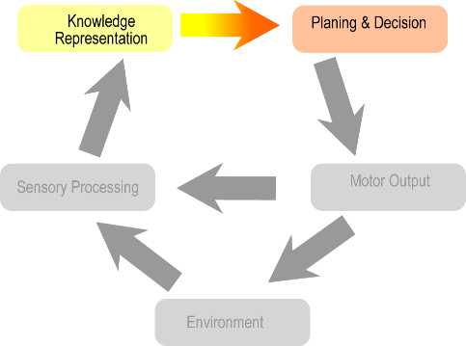
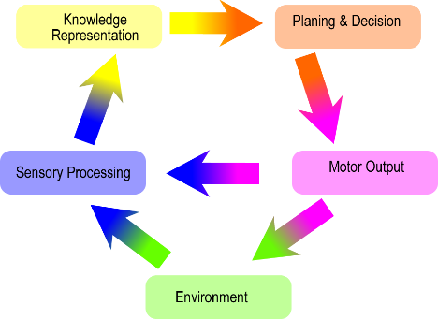
Approach: Training & Evaluation Environments
Task Area
Features
Cognitive Area
Sensory Perception
Identification/classification of spatio-temporal objects in animation or video
Multi-dimensional complexity variability
Core task of all cognitive systems
(Image removed)
Decision & Planning
Quantitative measures of complexity
Objective measures of performance
Easily scaled
Human interaction
“Abstract” cognition
(Image removed)
Navigation & Survival
Interaction in complex, dynamic environments.
Comparison to small animal studies
Exercises all levels of cognition
Most difficult to score and scale
(Image removed)
Approved for Public Release, Distribution Unlimited

Slide 13
Program Plan and Milestones
Approved for Public Release, Distribution Unlimited

Slide 14
Program Approach
System (SyNAPSE)
Model
Modules
(e.g. visual cortex)
Top-down
(simulation)
Make
Measure
Networks
(e.g. cortical column)
Biological Scale
Machine Intelligence
Employ theoretical and empirical approaches constrained by practicality.
Circuits
(e.g. center-surround)
Architecture
Components
(e.g. synapse / neuron)
Bottom-up
(devices)
Hardware
Simulation
Materials
(e.g. memristors)
Environment
Attack the problem “bottom-up” and “top-down” and force disciplinary integration with a common set of objectives.
Sponsor a suite of complementary capabilities to build, train, and evaluate devices.
Approved for Public Release, Distribution Unlimited

Slide 15
Program Components
Hardware will likely include CMOS devices, novel synaptic components, and combinations of hard-wired and programmable/virtual connectivity and will support critical information processing techniques like spike time encoding and spike time dependent plasticity.
Architectures will support critical structures and functions observed in biological systems such as connectivity, hierarchical organization, core component circuitry, competitive self-organization, and modulatory/reinforcement systems.
Large scale digital simulations of circuits and systems will be used to prove component and whole system functionality and to inform overall system development in advance of neuromorphic hardware implementation.
Environments will be evolving virtual platforms for the training, evaluation and benchmarking of intelligent machines
Approved for Public Release, Distribution Unlimited

Slide 16
Program Outline
Phase 0
Phase 1
Phase 2
Phase 3
Phase 4
Component synapse (and neuron) development
CMOS process and core circuit development
~10⁶ neuron single chip implementation “Mouse” level
~10⁸ neuron multi-chip robot at “Cat” level
Hardware
CMOS process integration
Microcircuit architecture development
System level architecture development
~10⁶ neuron design for simulation and hardware layout
~10⁸ neuron design for simulation and hardware layout
Architecture
& Tools
Comprehensive design capability
Simulate large neural subsystem dynamics
“Mouse” level benchmark
(~ 10⁶ neuron)
“Cat” level benchmark
(~ 10⁸ neuron)
Emulation
& Simulation
Preparatory studies only
Build Sensory, Planning and Navigation environments
“Small mammal” complexity
Add Audition, Proprioception and Survival
“All mammal” complexity
Preparatory studies only
Add Touch and Symbolic environments
Environment
Sustain
Program Phases 1-4 may be combined per the BAA instructions
Approved for Public Release, Distribution Unlimited

Slide 17
Phase 0 Go No-Go Metrics
Hardware
Synaptic density scalable to > 10¹⁰/cm²
Operating speed >10 Hz
Consumes < 10⁻¹² Joules per synaptic operation (at scale)
Dynamic range of synaptic conductance > 10 with >3 bit resolution
Synaptic conductance increase >1%/pulse for presynaptic spike applied somewhere within 80-1 msec before a postsynaptic spike
Synaptic conductance decrease >1%/pulse for presynaptic spike applied somewhere within 80-1 msec after postsynaptic spike.
0%-0.02% conductance decrease if presynaptic spike applied > 100 msec before or after postsynaptic spike
Maintains performance over 3 x 10⁸ synaptic operations
Architecture
Specify and validate by simulation the function of core microcircuit assemblies using measured synaptic properties.
The microcircuits must support the larger system architecture and support spike time encoding, spike time dependent plasticity, and competitive neural dynamics.
~ 9 months
Approved for Public Release, Distribution Unlimited

Slide 18
Go/No-Go Milestones Set 1
Hardware
Demonstrate all core micro-circuit functions in hardware
Specify a chip fabrication process supporting the architecture with >10¹⁰ synapse/cm² and >10⁶ neurons/cm²
Architecture
Demonstrate a complete neuromorphic design methodology that can specify all the components, subsystems, and connectivity of a complete system.
Specify a corresponding electronic implementation of the neuromorphic design methodology supporting > 10¹⁴ synapses, > 10¹⁰ neurons, mammalian connectivity, < 1 kW, < 2L
Simulation
Demonstrate dynamic neural activity, network stability, synaptic plasticity and self-organization in response to sensory stimulation and system-level modulation/reinforcement in a system of ~ 10⁶ neurons modeled on mammalian cortex
Environment
Demonstrate virtual Visual Perception, Decision and Planning, and Navigation Environments with a selectable range of complexity corresponding roughly to the capabilities demonstrated across a ~10⁴ range in brain size in small-to-medium mammalian species
Approved for Public Release, Distribution Unlimited

Slide 19
Go/No-Go Milestones Set 2
Hardware
Demonstrate chip fabrication of >10¹⁰ synapse/cm², >10⁶ neurons/cm²
Architecture
Design a neural system of ~10⁶ neurons and ~10¹⁰ synapses for simulation testing
Design a corresponding single chip neural system of ~10⁶ neurons and ~10¹⁰ synapses
Simulation
Demonstrate a simulated neural system of ~10⁶ neurons performing at “mouse” level in the virtual environment
Environment
Expand the Sensory Environment to include training and evaluation of Auditory Perception and Proprioception
Expand the Navigation Environment to include features stressing Competition for Resources and Survival
Demonstrate a selectable range of complexity corresponding roughly to the capabilities demonstrated across a ~10⁶ range in brain size mammalian species
Approved for Public Release, Distribution Unlimited

Slide 20
Go/No-Go Milestones Set 3
Hardware
Fabricate a single chip neural system of ~10⁶ neurons and package into a fully functioning assembly. Show “mouse” level performance in the virtual environment.
Architecture
Design a neural system of ~10⁸ neurons and ~10¹² synapses for simulation testing
Design a corresponding single chip neural system of ~10⁸ neurons and ~10¹² synapses
Simulation
Demonstrate a simulated neural system of ~10⁸ neurons performing at “cat” level
Environment
Add Touch to the Sensory Environment
Add Symbolic Environment
Approved for Public Release, Distribution Unlimited

Slide 21
Final Metric – Milestone Set 4
Hardware
Fabricate a multi-chip neural system of ~10⁸ neurons and instantiate into a robotic platform performing at “cat” level
Approved for Public Release, Distribution Unlimited

